Slide 1
bookly
final presentation
Notes:
Vision noch mitteilen

Slide 2

Outline
Use Cases
Project Management
Architecture
Quality
Demo

Slide 3
Use-Cases

Slide 4
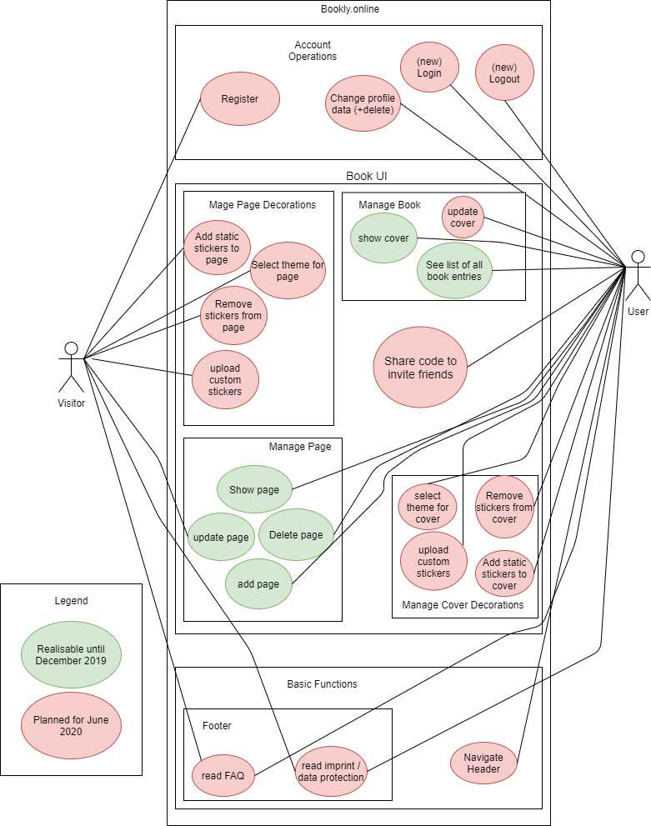
Extend of functionality
TODO: Update Bilder

Slide 5
Extend of functionality

Slide 6
Use CaseS for Mockup
CRUD: Manage page
C: create page entry (UC 1)
R: read an entry (UC 2)
U: update/edit an entry (UC 3)
D: delete an entry (part of account)
CRUD: Manage book
C: create a book (UC 4)
R: show cover/title (UC 5)
U: update cover/title (UC 6)
D: delete (part of account)
TODO: Legende

Slide 7
Use CaseS for Mockup
Share code to invite friends (UC 7)
CRUD: Manage Page Decorations (UC 8)
C: create sticker
R: read sticker
U: update sticker
D: delete sticker
Navigate Footer (UC 10)
Navigate Header (UC 11)
Operate Account
CRUD: Manage Cover Decorations (UC 9)
C: create sticker
R: read sticker/theme
U: update sticker/theme
D: delete sticker

Slide 8
Cost Estimation
TODO:
Cost Estimation (FP -> time (time is money)) / comparison of estimation vs. real time spent.

Slide 9
Project Management

Slide 10
RUP- Rational Unified Process
Alexandra
Requirements Specifier: Describe and phrase the features / design of the website with the team
Project Manager: Phrase acceptance criteria of the features + Coordinate sprints + Manage YouTrack + Assign Tags
Jeanne
Implementer: Create database structure, logic, and interfaces (API)
Tester: Test the interfaces (APIs) between Frontend, Backend, Database and the functionality of the Frontend
Nico
Deployer: Host domain and integrate CI (and Docker)
Designer: Implement the design described in the Use-Cases + Web tests

Slide 11
RUP- Workflow

Slide 12
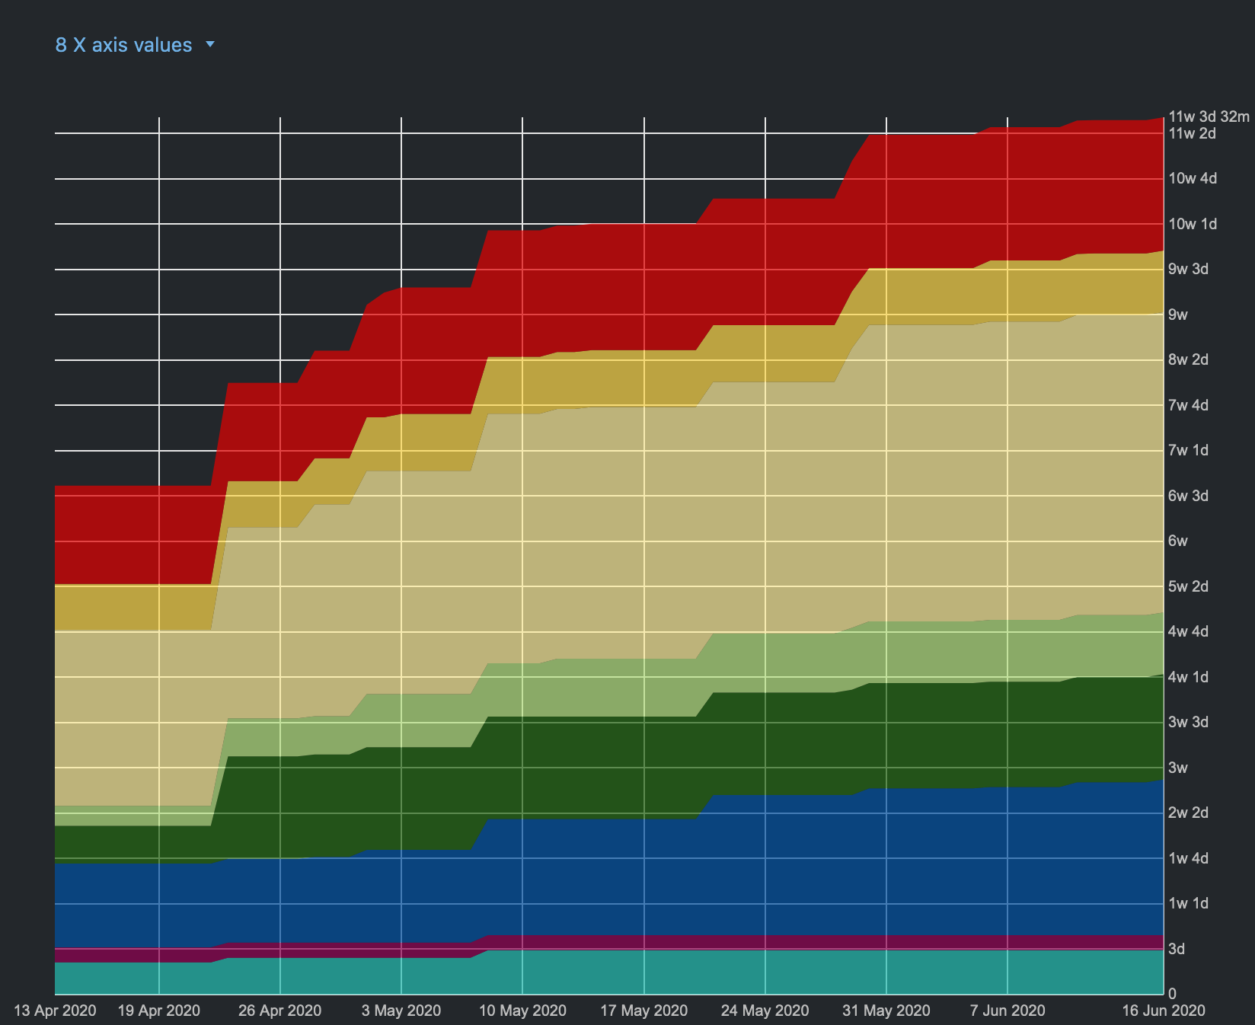
RUP- Workflow - 2020

Slide 13
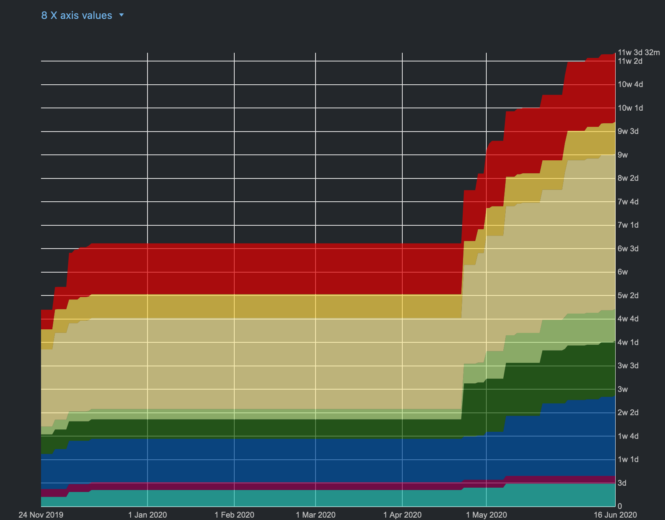
RUP- Workflow - complete

Slide 14
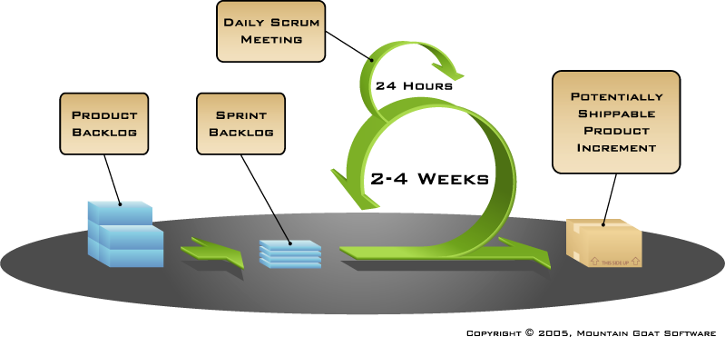
Scrum and Youtrack
weekly
Notes:
Youtrack integriert in IntelliJ als Plugin und in Git

Slide 15
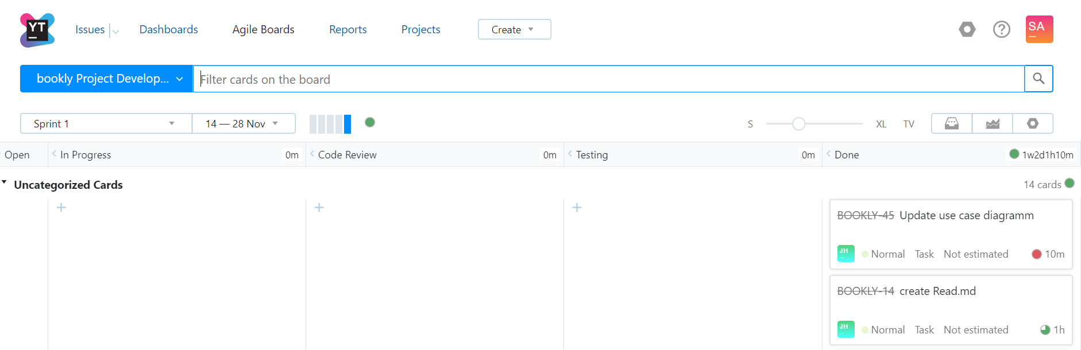
Scrum and Youtrack

Slide 16
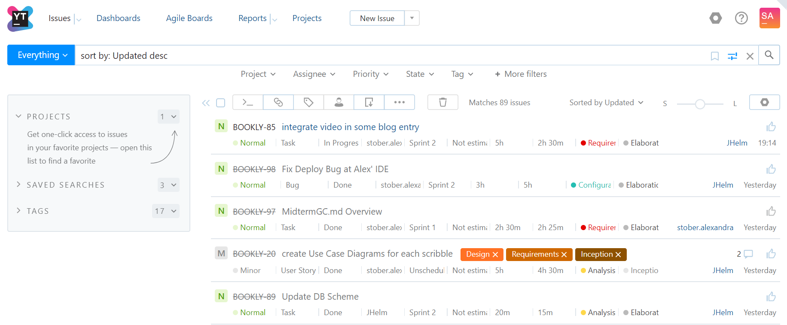
Scrum and Youtrack

Slide 17
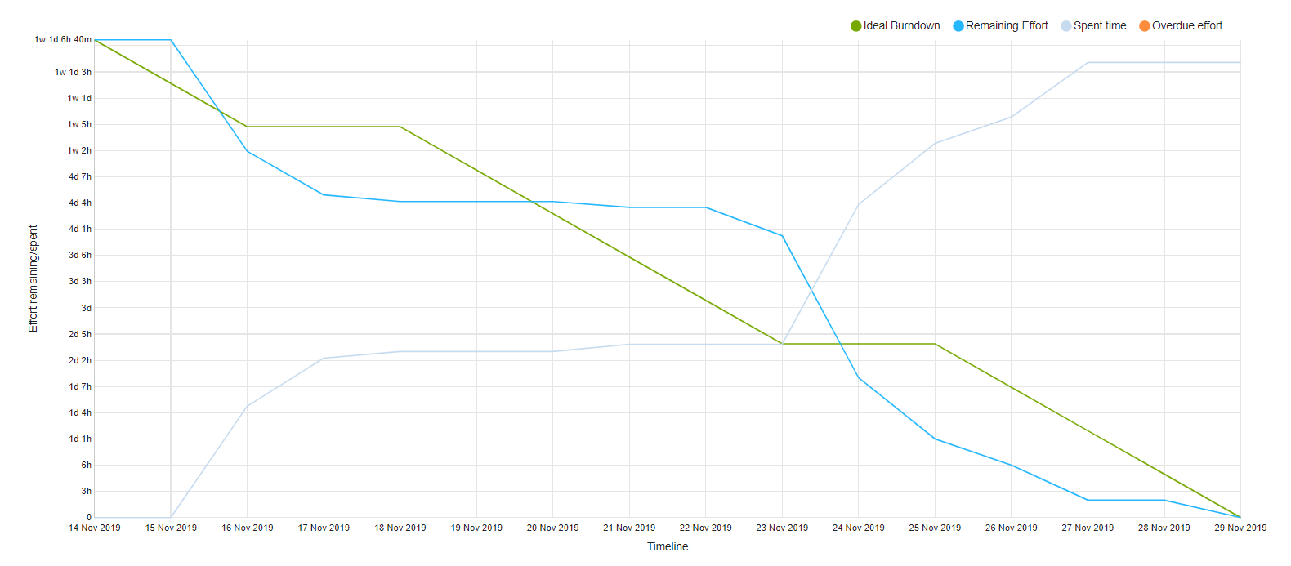
Burn-Down-Chart
► more

Slide 18
Risk Management
Risk Mgmt.- (excel sheet that shows that you have a list of risks that you kept up to date on a weekly basis, how you mitigated risks - dont show an xcel sheet during a presentation!)
-> BUT DO NOT SCROLL THROUGH AN EXCEL IN THE PRESENTATION!

Slide 19
Architecture

Slide 20

Main Idea

Slide 21
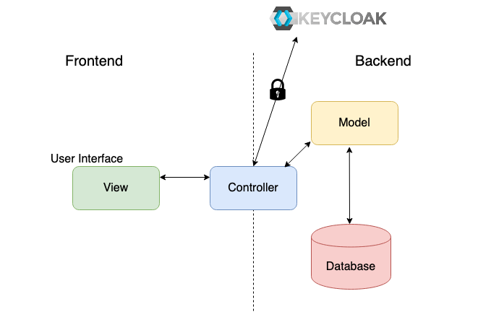
Overview

Slide 22
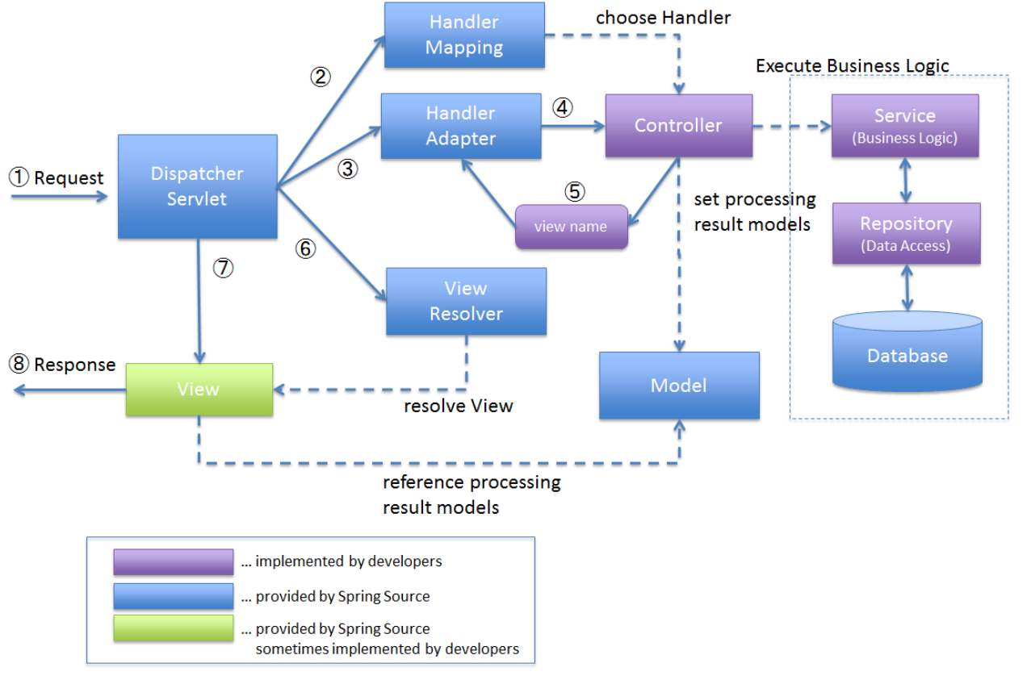
Architecture – Overview

Slide 23






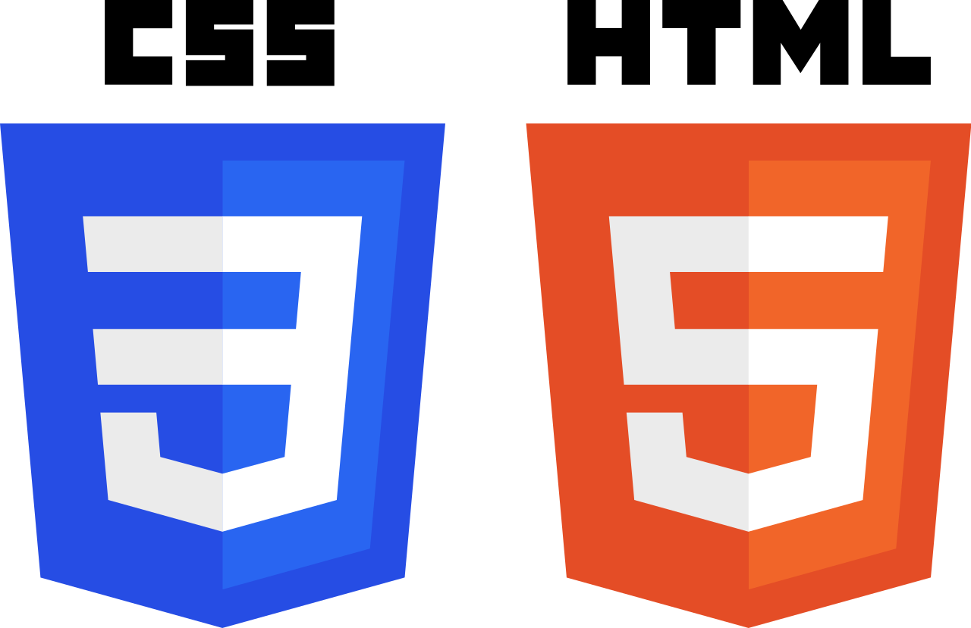










Technology
Backend
Frontend
Testing
Deployment

Slide 24
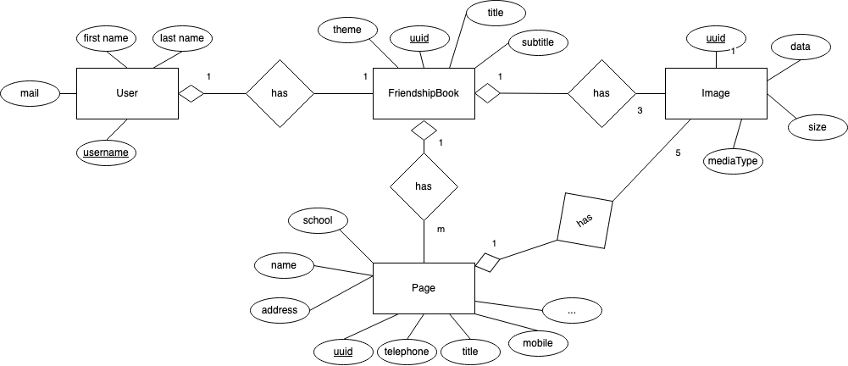
Database scheme – Data View
Notes:
bunter machen

Slide 25
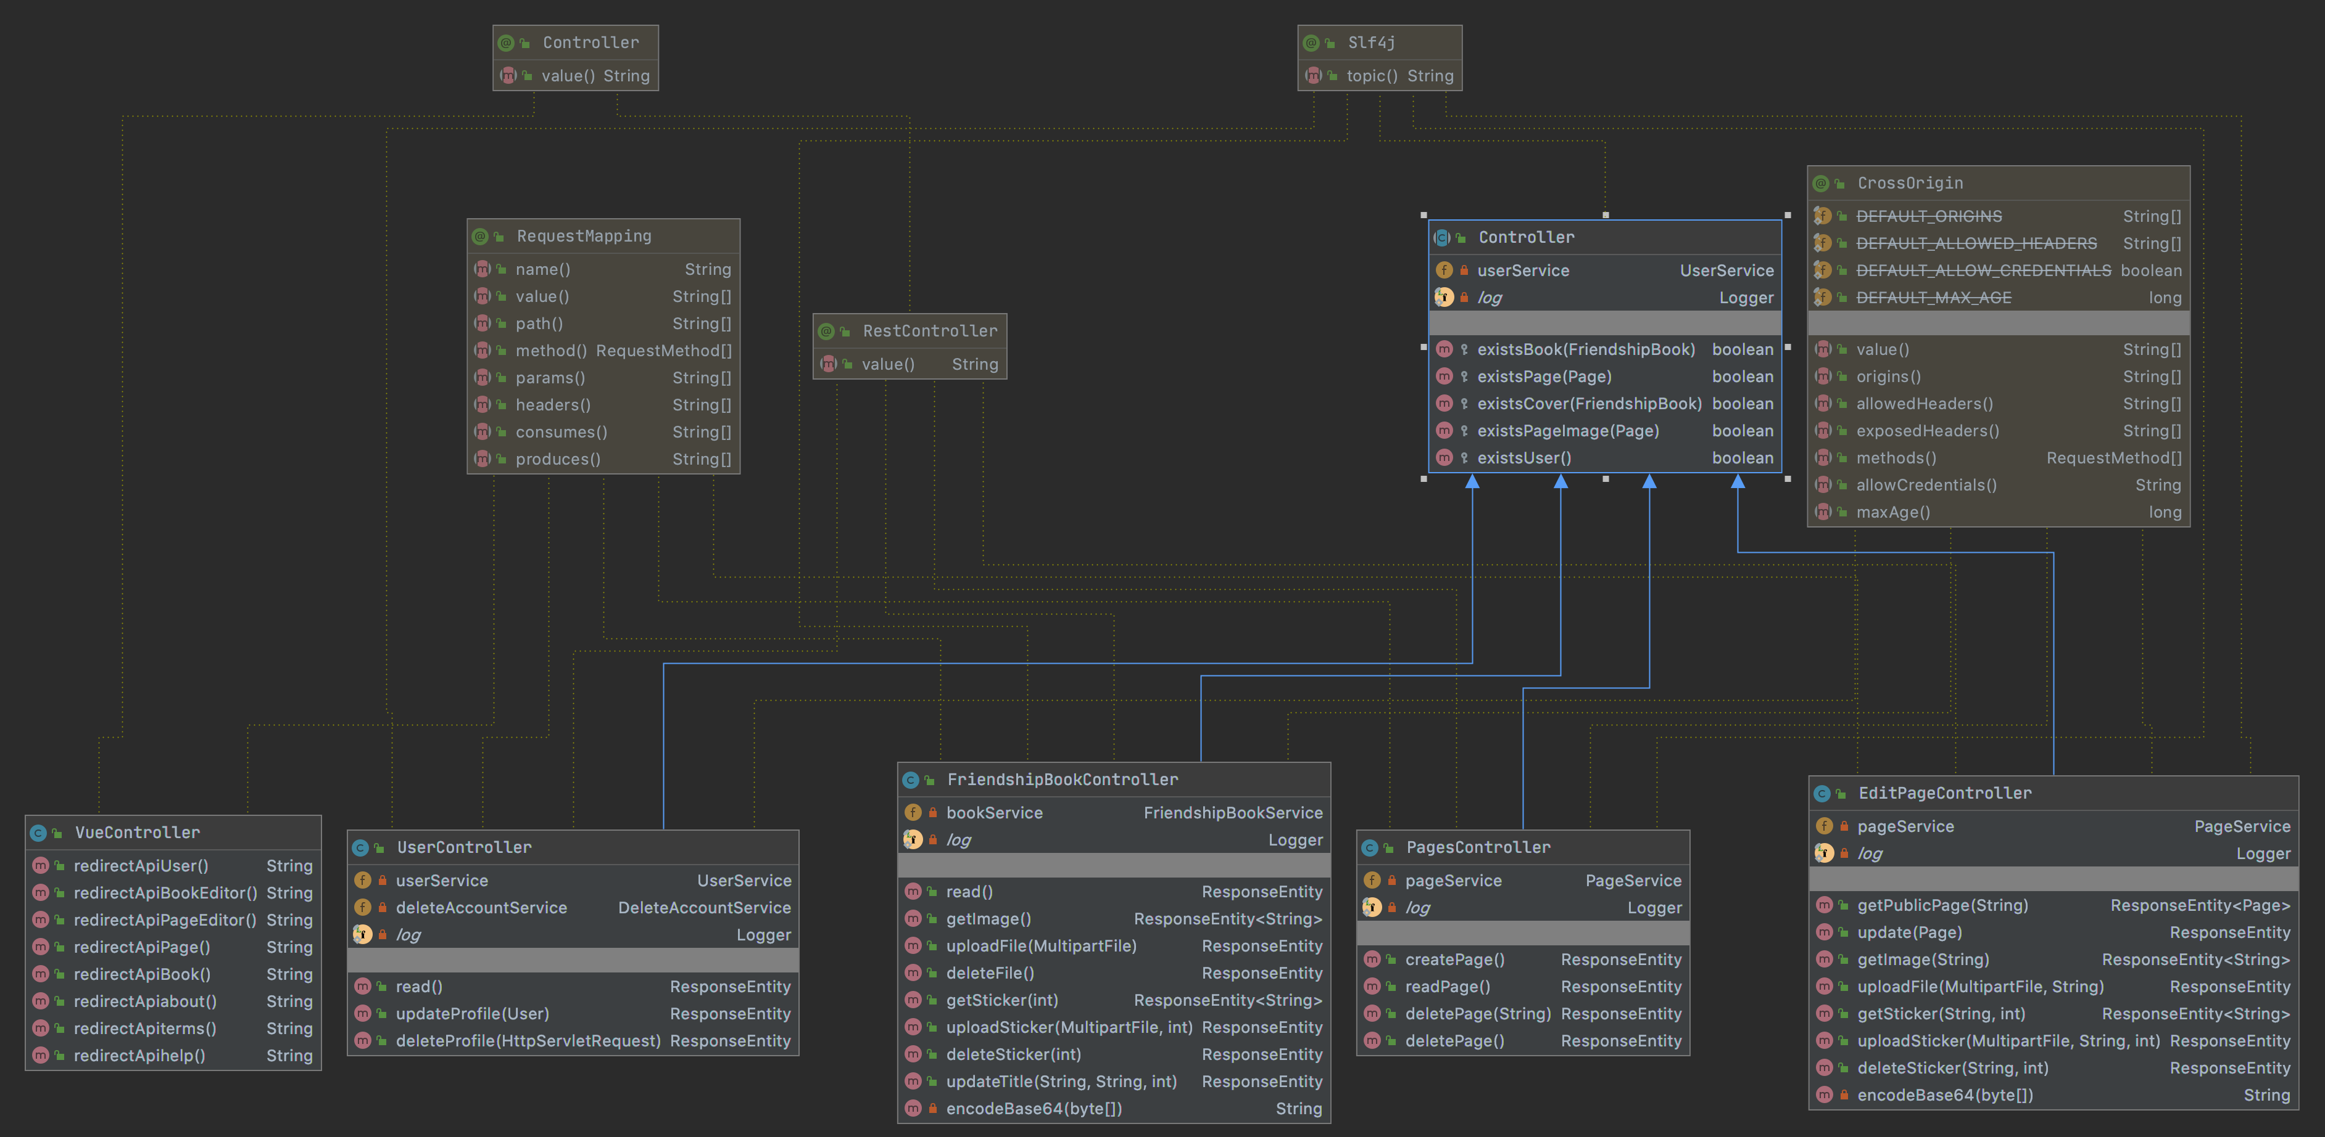
Class Diagram - Controller

Slide 26
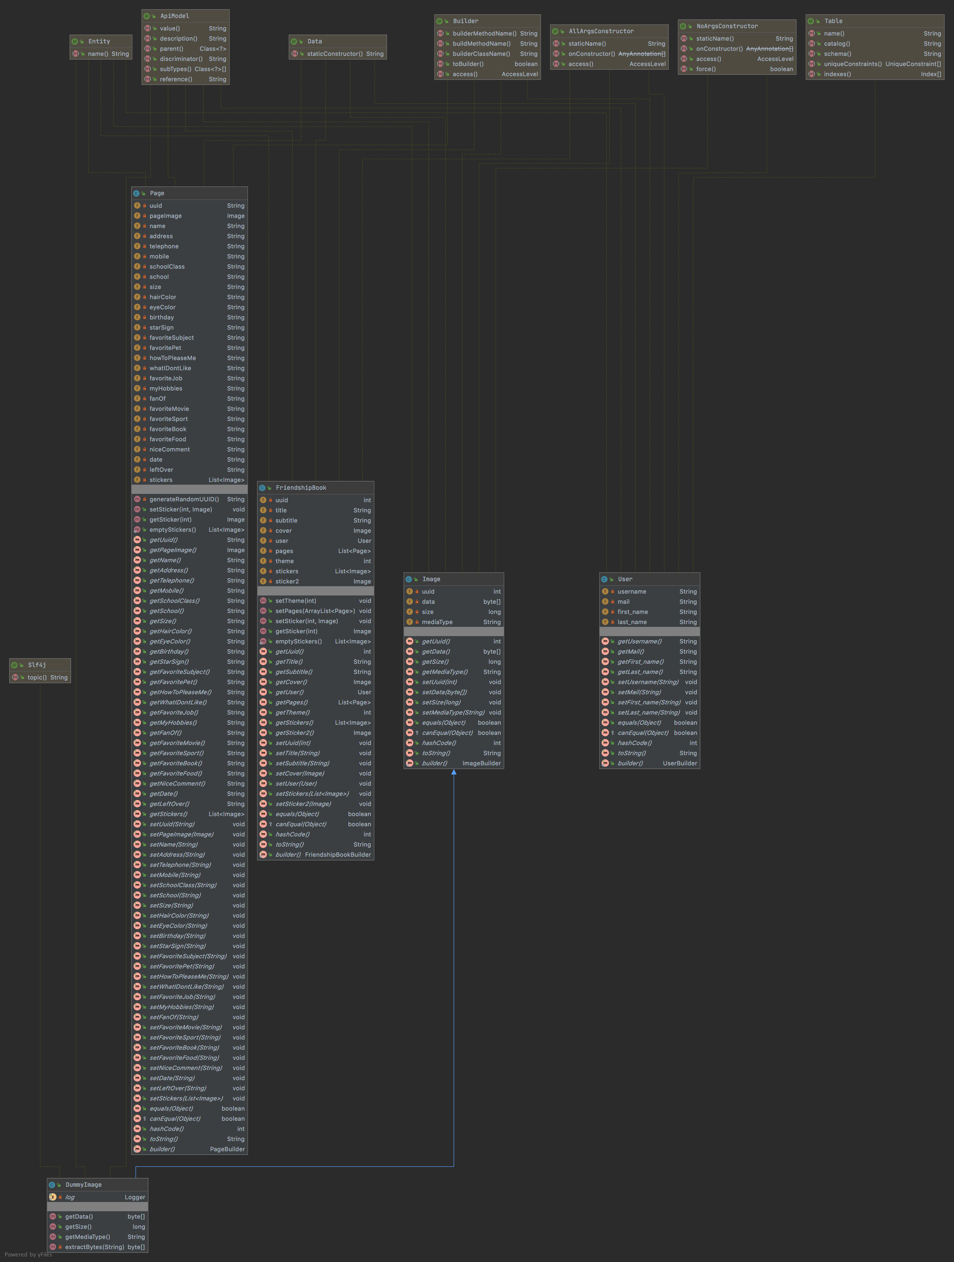
Class Diagram Model
►Whole view

Slide 27
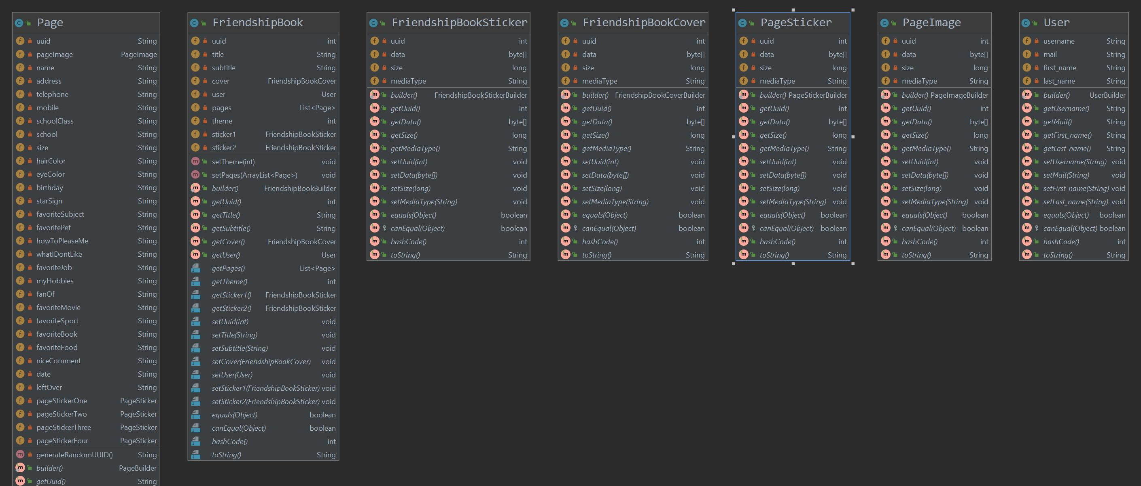
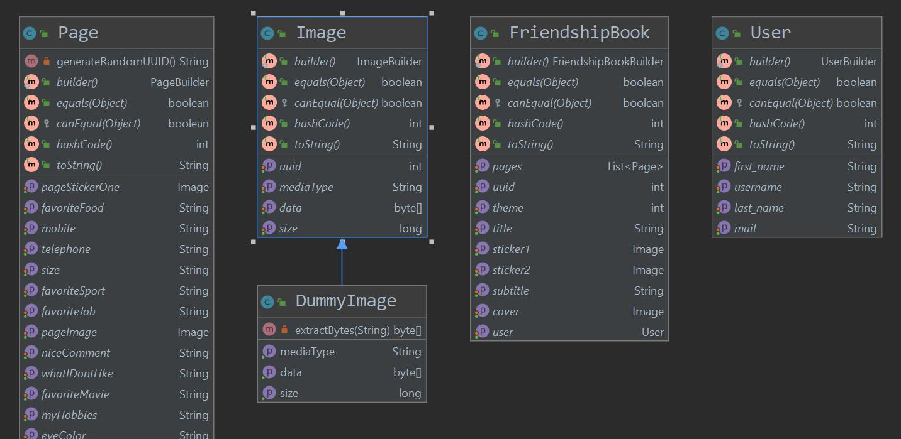
Design Patterns: Null Object
◀︎ before
After ▶︎
Notes:
dummy image hervorheben

Slide 28
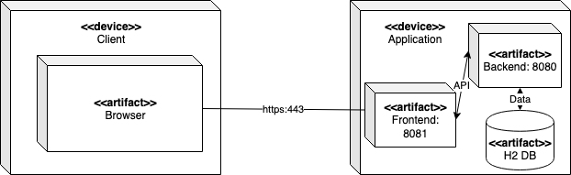
Architecture – Deployment View

Slide 29
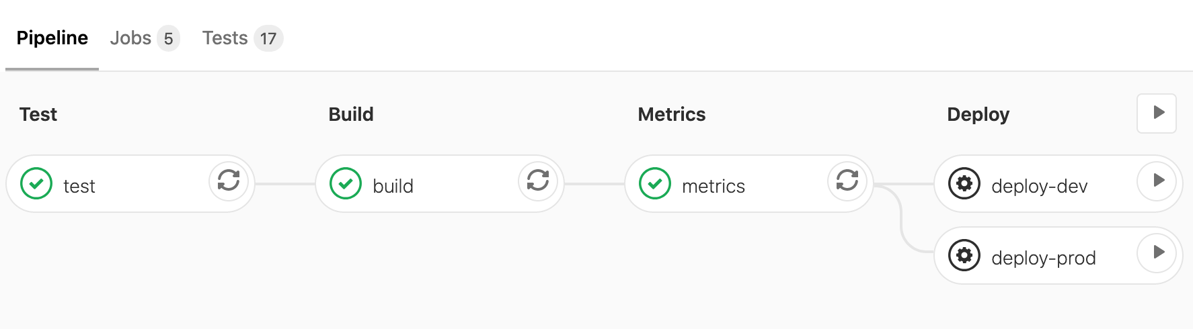
Continous Integration
Pipelines Test ► Build ► Metrics ► Deploy (automatic or manual)

Slide 30



Continous Integration
What | Code | Push to GitLab | Test Application | Metrics | Build Application | Deploy to Server
When | continously | Code is ready |  |  |  | + we decide
Where |  |  | ▼ ▼ | ▼ | ▼ | dev-system or stage-system
after
after
after
after

Slide 31
QUality

Slide 32
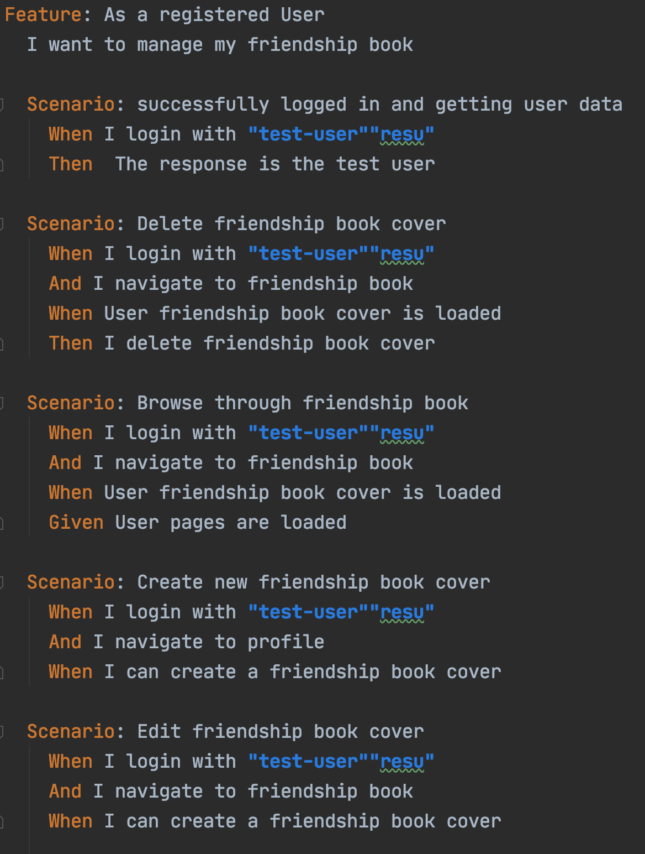

Testing
Automatic testing
Test results visible on GitLab per commit
BDD tests with cucumber
JUnit tests
Database tests
Field Test
Test Coverage

Slide 33
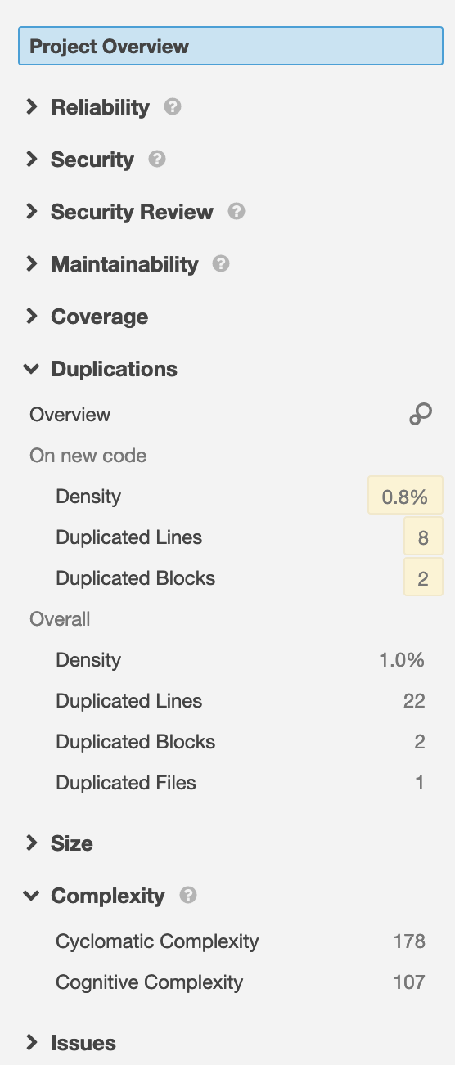
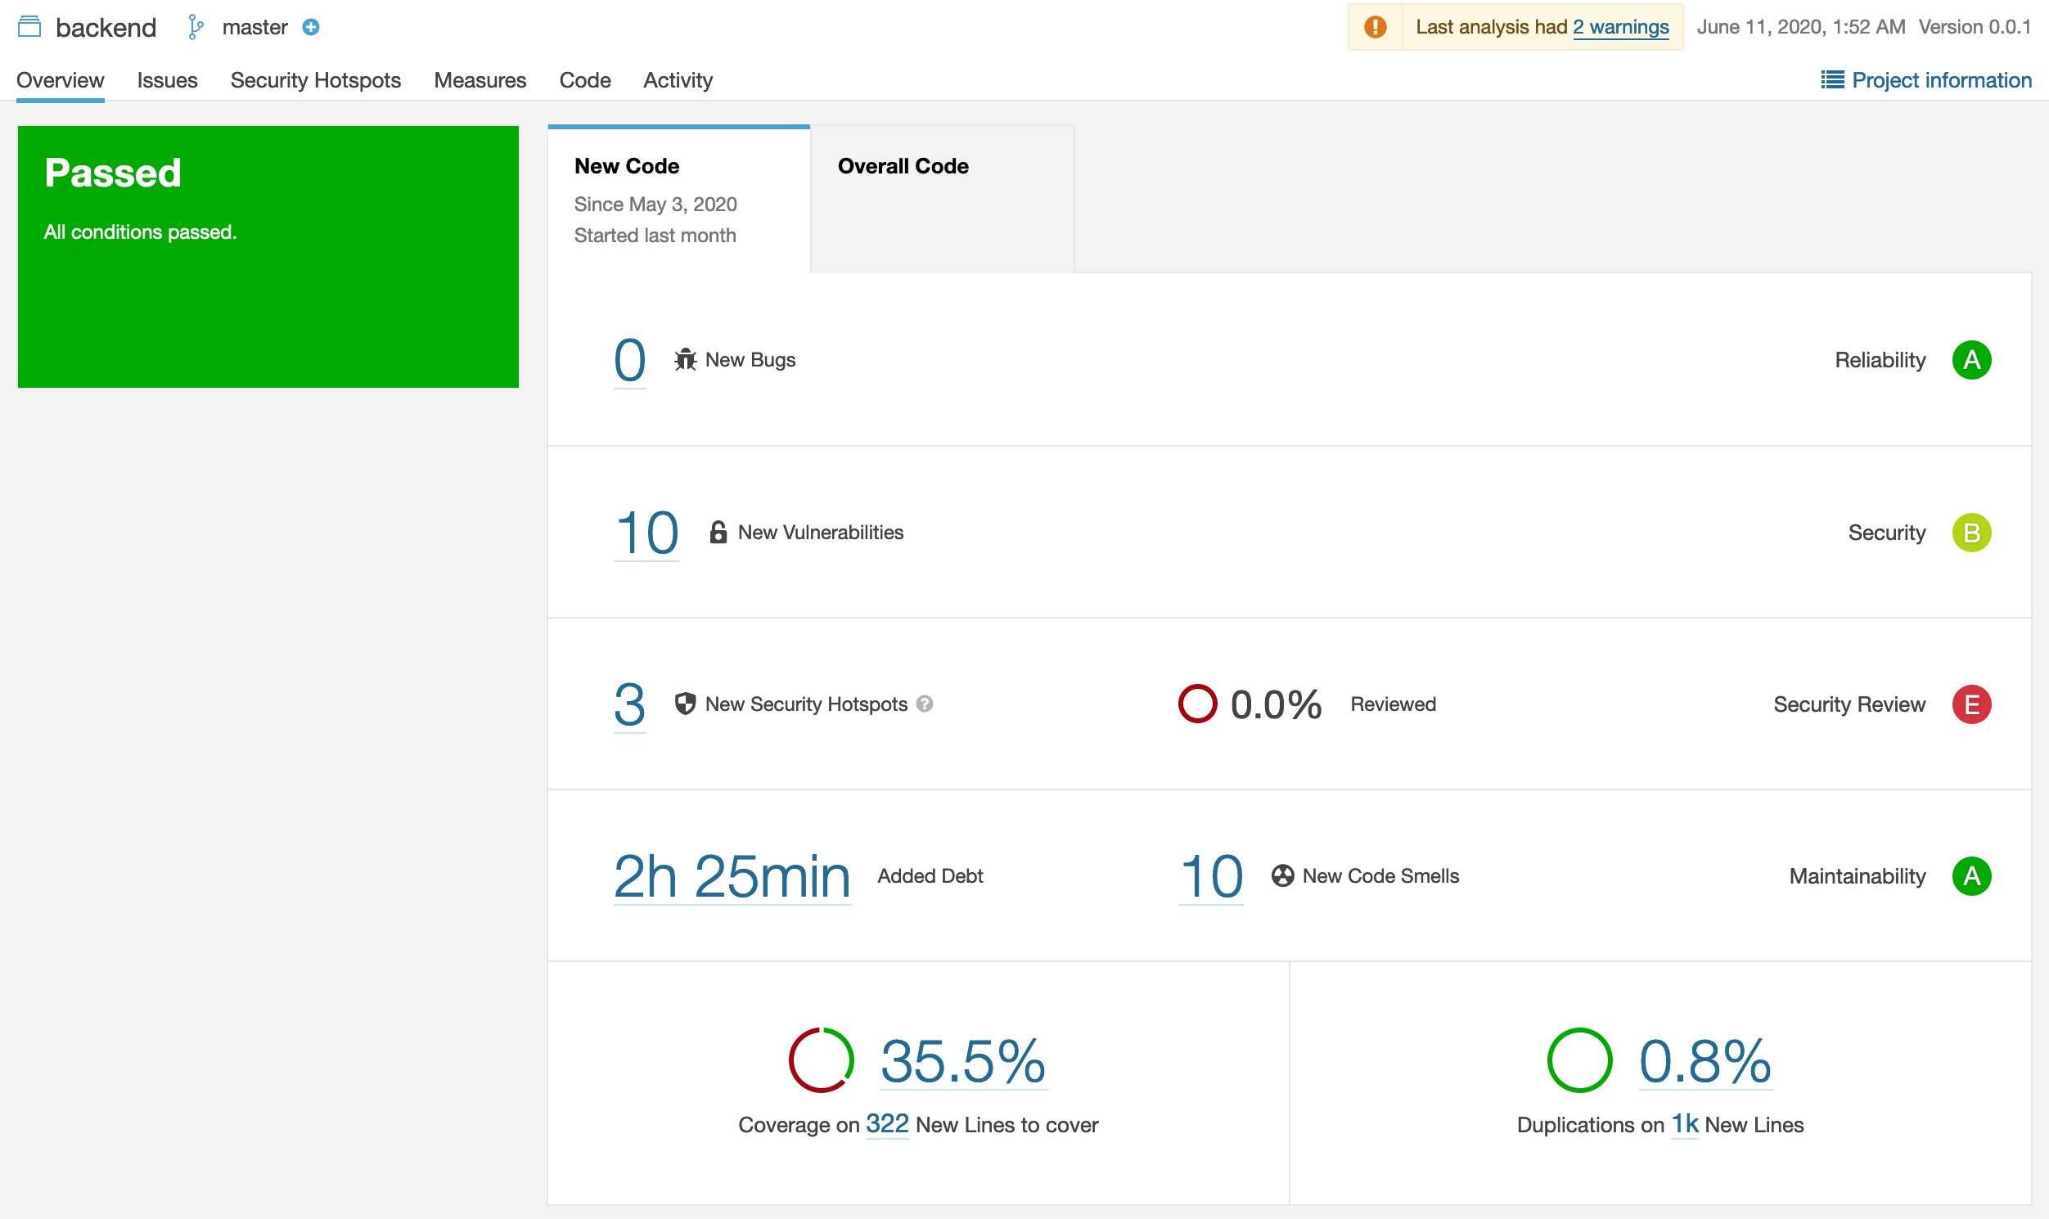
Metrics
▶︎Sonarqube

Slide 34
DEMO
BOOKLY - friendship book

Slide 35
Bookly Documentation
TODO: Links
TODO: Gantt Chart (Ausschnitt und dann ein Link)

